Slide 1

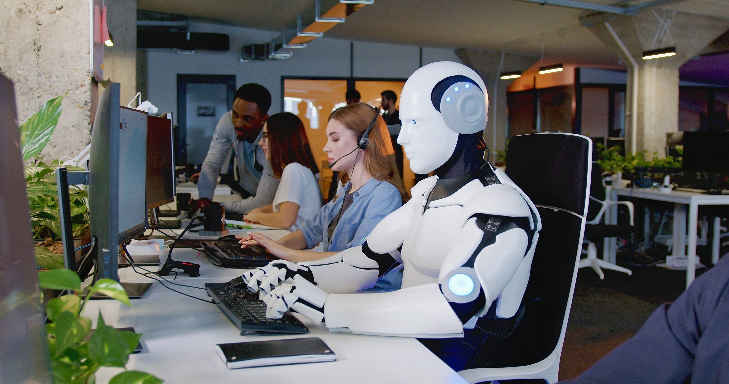
reduces cost by 63% and improves conversion by 3x
Out Reaching by Voice calling AI Agent in India deployed

Slide 2
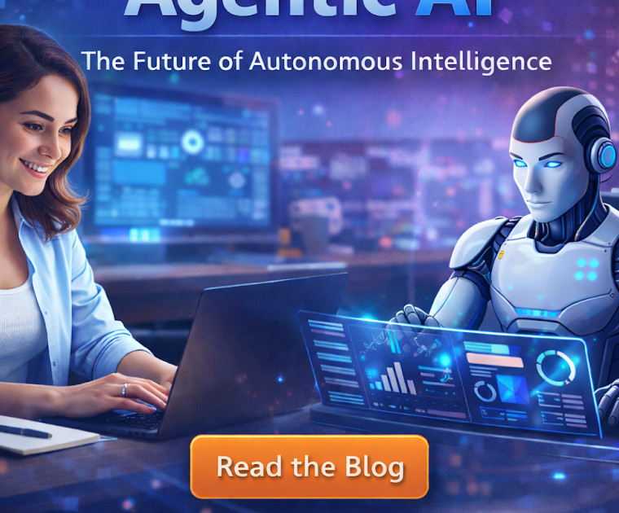

Listen to the AI Agent call
-Indian Language (Hinglish), various other
-Impromptu response
Client out reach &follow up 24X7 on automation
Rresponse recording for deal closure and further business action
Human like Conversation by AI

Slide 3
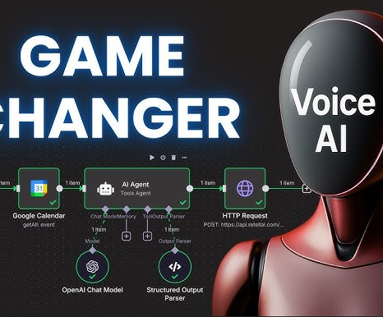
ULTIMATE ROI Machine
Delivered Reduction in manpower cost by 63%
Delivered Improved Conversion by 3X
Improved productivity – Improved PROFITS

Slide 4
